Slide 1
CAES Collaboration Funds 2022

Slide 2
Amy Woodard
CAES Business Operations Lead

Slide 3
Collaboration Funds Q&A Agenda
Introduction
Discuss CAES Collaborative Initiatives
What is CAES Collaboration Funds?
Goals and Objectives
Process and Alignment
Examples of Successful Proposals
Timeline

Slide 4
Introduction
What is CAES?
The Center for Advanced Energy Studies is a research, education, and innovation consortium between INL, Boise State, Idaho State University, and University of Idaho.
CAES Vision
Our vision is to create a better energy future through collaboration that inspires energy leadership, ignites technology innovation, and catalyzes global impact.
CAES Mission
CAES is the collaboration that inspires innovation and impact by leveraging our collective capabilities to empower students, researchers, faculty, and industry to accelerate energy solutions.
CAES Collaboration Funds
The CAES Collaboration Fund is designed to help establish collaborative research, innovation, and educational relationships between INL researchers and the CAES universities - Boise State, Idaho State University, and University of Idaho.

Slide 5
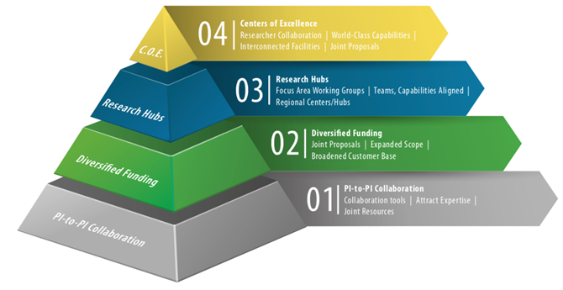
CAES Collaboration Initiatives
CAES initiatives focused on building collaboration include:
CAES Summer Visiting Faculty Program
CAES Fellows
CAES Collaboration Funds
ISU CAES Seed Grant Program

Slide 6
CAES Collaboration Funds
Heading into its fifth year, this program is designed to be INL Principal Investigator led with CAES university collaboration.
The program allows more flexibility for the INL PI to develop funding proposals, deliverables, and funding mechanisms to enable collaboration.
31 INL researchers have been awarded CAES Collaboration Funds in 2018-2021, each paired with faculty from at least one CAES university.
Who’s eligible: INL researchers
Approximate budget: $250-300K overall
Average Award: $20-40K
Application Deadline: March 18, 2022
Award Announcement: March 31, 2022
Final Deliverables Due: September 30, 2022
Travel Restrictions due to COVID apply

Slide 7
Goals and Objectives
CAES Collaboration Funds are designed to bring together Idaho National Laboratory (INL) researchers and CAES university members to interact, build new relationships, and develop joint funded research programs with the aim to grow external funding in CAES focus areas.
Therefore, these program development funds can be used for the following:
Labor costs for individuals working on activities specifically directed at the development of new collaboration (e.g., initiative planning, proposal development time, graphics, technical writing, and editing)
Development of concept papers, strategy, or documentation
Cost associated with targeted market research to obtain a better understanding of current or potential customer needs that will then be factored into strategy or business plans
Costs associated for travel for discussion with customers or potential customers to develop/define work scope and identify funding for new programs (limited by COVID travel restrictions)
Travel and labor to a symposium/conference/workshop provided recipient is (1) presenting/hosting CAES research and capabilities or (2) manning booths (limited by COVID travel restrictions)
CAES Collaboration Funds may not be used to co-mingle with Direct-funded INL Programs or LDRD-funded projects.
Funds may not be used to collect data or perform R&D experimental activities.

Slide 8
CAES Collaboration Funds Process and Alignment
Funds will be granted to strategic and innovative proposals through an open application process
An internal CAES review for strategic alignment and best return on investment.
A high priority will be placed on proposals tied to future direct-funded work such as through a DOE solicitation.
Successful applicants will demonstrate how their proposal would enhance collaborative relationships among the CAES entities in in at least one of the seven focus areas outlined the CAES Strategy.
CAES Focus Areas:
Energy Policy
Advanced Manufacturing
Energy-Water Nexus
Nuclear Energy
Cybersecurity
Innovative Energy Systems
Computing, Data, and Visualization

Slide 9
Examples of Successful Proposals/Deliverables
Proposal #1:
Collaborative proposal written between INL, a CAES member University, and/or an industrial partner;
Submit collaborative proposal to FOA;
Literature search performed by student(s);
Summary of the discussions for each meetings;
Report on the outcome of the travel to industry to establish partnerships; and
Report by the parties involved on the possibility of establishing particular focus area.
Proposal #2:
Develop new concepts or proposal in applicable focus area;
Visit CAES university (virtually), attend a seminar, and mentor students; and
Provide a white paper on future collaborative proposal.

Slide 10
Collaboration Fund Timeline
March 18
Applications due at 5 pm via CAES website, to apply Click here
March 19-30
CAES Programmatic Team to review applications
March 31
Award recipients announced
April 1 to September 30
Funding mechanism initiation (contracts) and monthly updates
September 30
Deliverables Due/Final Presentation

Slide 11
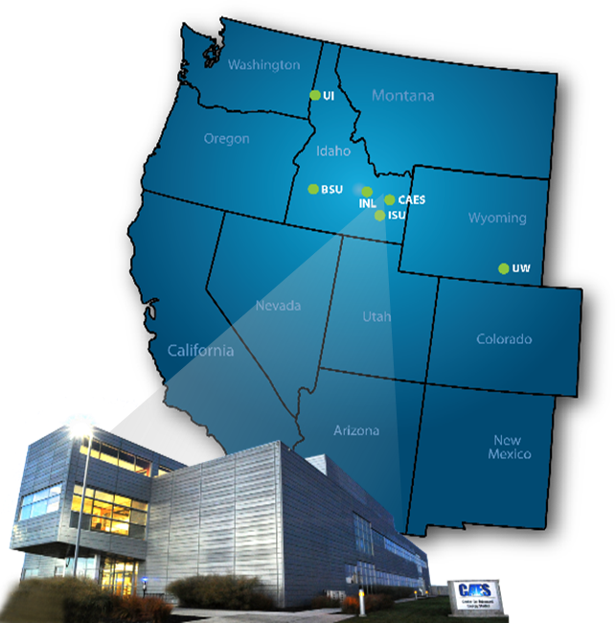
Questions
For more details, please contact: amy.woodard@inl.gov

Slide 12
Collaboration Inspiring Innovation and Impact

